Slide 1
Hong Kong University

Slide 2
Portable Pulse Oximetry Device

Slide 3
Display
Model no.: TJCTM24028-SPI
Communications
SPI (Serial Peripheral Interface)
Library
Adafruit_ILI9340 (Driver library)
Adafruit_GFX (Graphics library)
Functions:
Display 320x240 pixels
Save & Load in SD card
Touch Screen

Slide 4
Cost
Due + Display ($85+$70 = $155 from Taobao)
OpAmp
LED & PD
Regulator (3.3V)
Jumper wire

Slide 5
Loop time management
Minimize display time, waveform updating method is changed
From whole screen refresh > vertical line refresh > point refresh
Utilize waiting time for the PD to reach the maximum
Original:
Turn on LED > wait > get PD signal > off > repeat for another LED
Now:
Turn on LED1 in initialization
Loop : obtain PD signal (LED1) > off LED1 > on LED2 > display waveform > obtain PD signal > off LED2 > on LED1 > the entire code > repeat

Slide 6
Loop time management
Perform different tasks in different loops
Loop 1-9: Calculation
Loop 10: display heart rate
Loop 11-19: Calculation
Loop 20: display SpO2
Repeat
Loop time now: ~6000us (For 80Hz, allowed loop time: 12500us)

Slide 7
Loop time management
Setup:
Turn on LED1
Wait
Loop:
Obtain PD signal (LED1)
Off LED1
On LED2
Display waveform (Wait)
Obtain PD signal (LED2)
Off LED2
On LED1
Remaining Code (Calculations or Displaying value)

Slide 8
Algae from AFCD

Slide 9
Experiment details
Flow rate : 40-10uL/hr
Channel: smallest @80X80 capture @80(H)X400(W) μm
Nikon image resolution: 2592 x 1944px 185x139μm ; pixel size = 0.07 x 0.07 μm
Motic video resolution: 2048 x 1536px 209x157μm ; pixel size= 0.1 x 0.1 μm

Slide 10
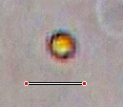

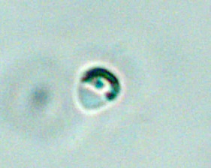
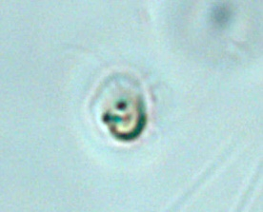
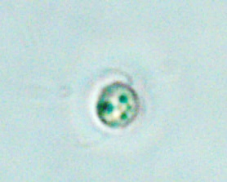
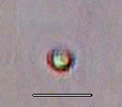
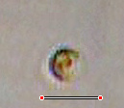
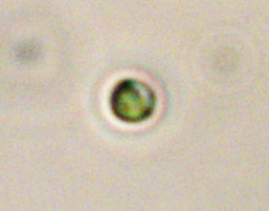
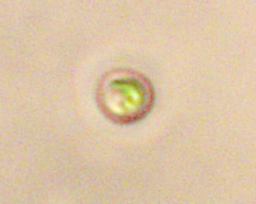
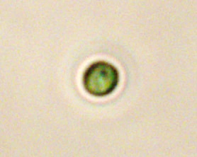


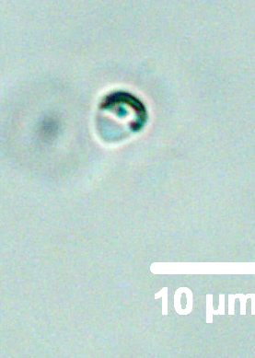
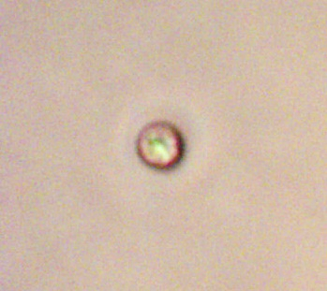
Selected Images of algae obj:40x
 | Static Image by NiU phase contrast | In-flow image by Motic phase contrast (count)
1. Isochrysis Around 6*6 um |  | 3506
2. Chaetoceros gralisis Around 2*3um |  | 1287
3. Tetraselmis Around 5*5um |  | 2387
10μm
Notes:
60*60

Slide 11
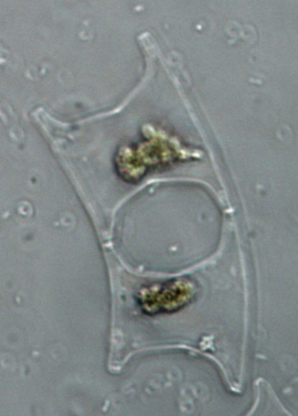
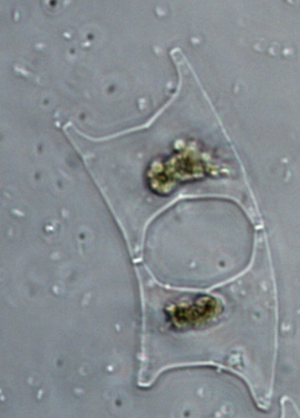
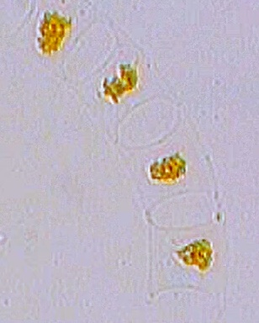
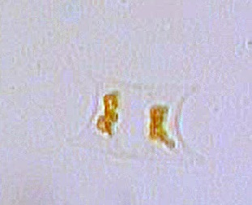
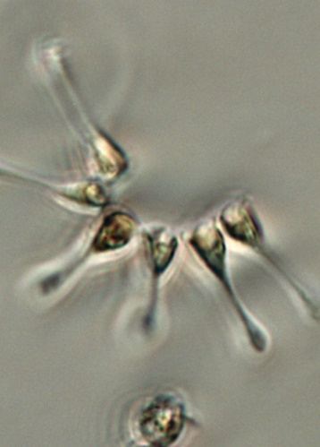
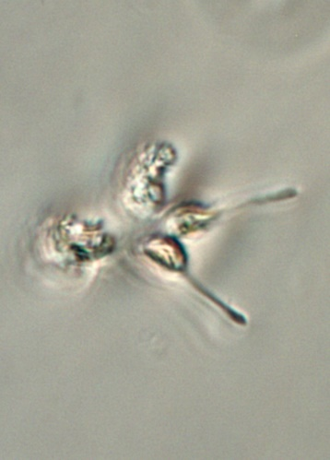
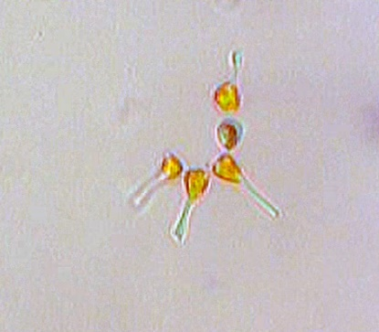
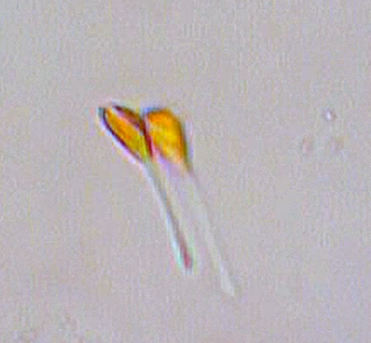
40μm
50μm
 | Static Image (NiU phase contrast) | In-flow image (Motic phase contrast) (count)
4. Eucampia zodiacus Around 50*30um |  | 45
5. Asterionella glacialis Around 34*11um |  | 11610(many repeat)
30μm
30μm
30μm

